Slide 1

UseR! 2019
Toulouse, France
AfricaR Initiative
Shelmith N. Kariuki Dennis Irorere

Slide 2
Who are we?

Slide 3
Mission:
To achieve improved representation and empower the African population of all genders, who are underrepresented in the global R community.
Support already existing R User Groups (RUGs) across Africa, and R enthusiasts to embrace the full potential of R programming.
Through fostering a collaborative continental network of R gurus, mentors, learners, developers and leaders, to help facilitate individual and collective progress worldwide.

Slide 4
Why AfricaR?

Slide 5
Why AfricaR?
Many R users in Africa, who did not know of the larger global #rstats community.
Lack of awareness about R Conferences that we can apply for, and attend, through diversity scholarships.
People learning R, but are not aware of where/how to apply the skills they learn.
Education system is lacking. Some campuses teach R, but the curriculum is not exhaustive.
“Battle” between R and Python:
Employment JDs prioritize Python over R
Python communities stronger than R community.
Data Science Africa
Pycon
IndabaX

Slide 6
What ideas do we have for AfricaR?

Slide 7

01: Adopt and nurture an African RUG
Notes:
Developed R User Groups mentoring/supporting new R User Groups
<number>

Slide 8

02: Seek remote internships / jobs for students fresh from school

Slide 9
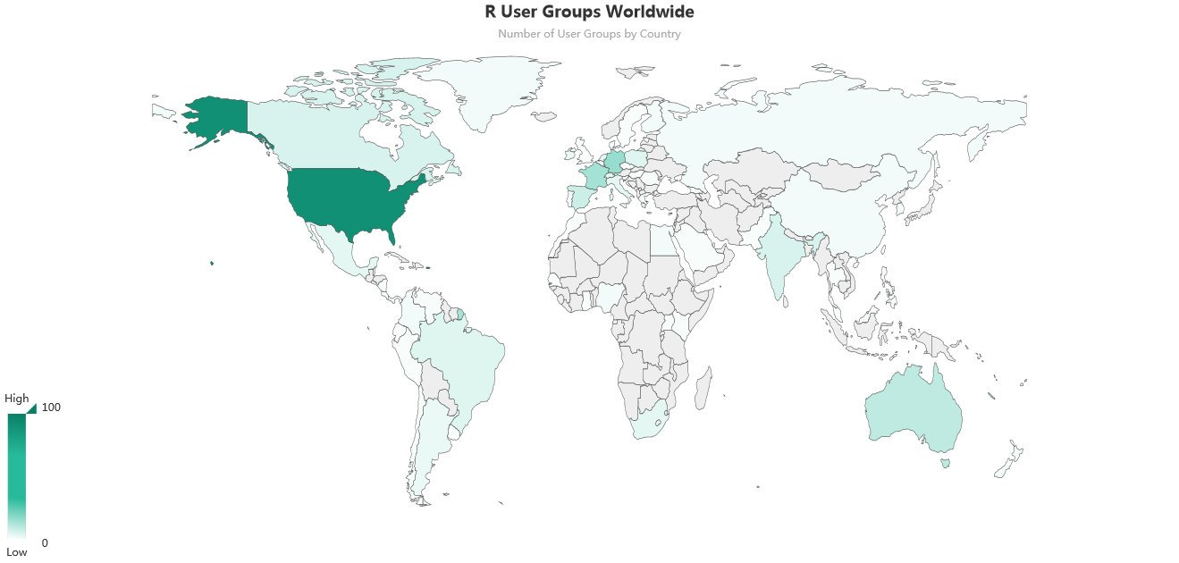
03: Spring up as many African RUGs

Slide 10
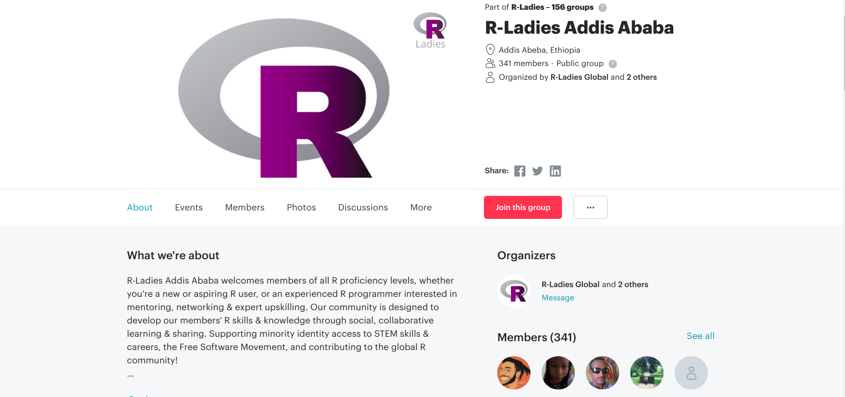


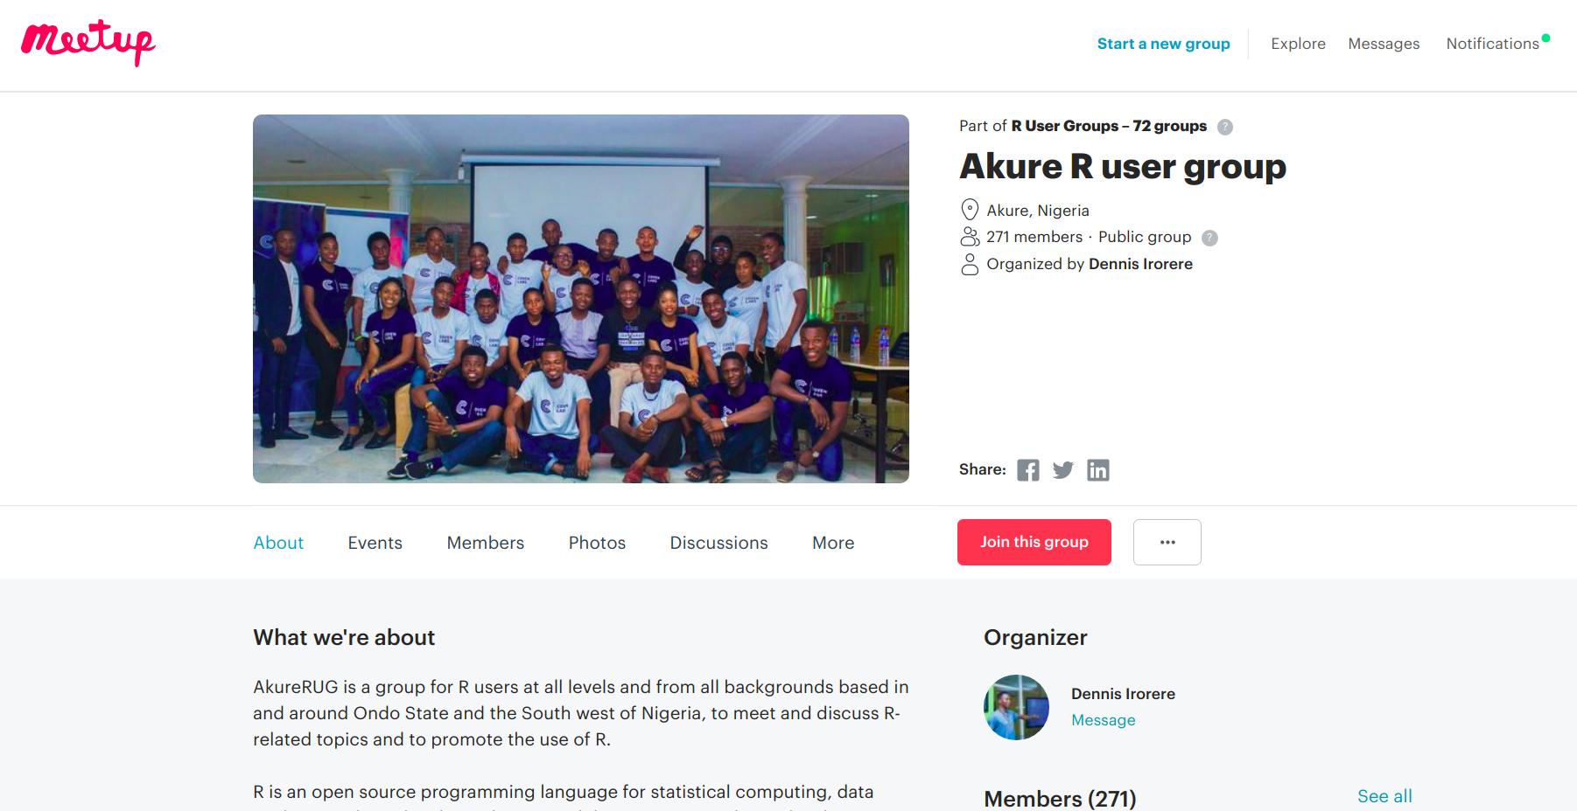
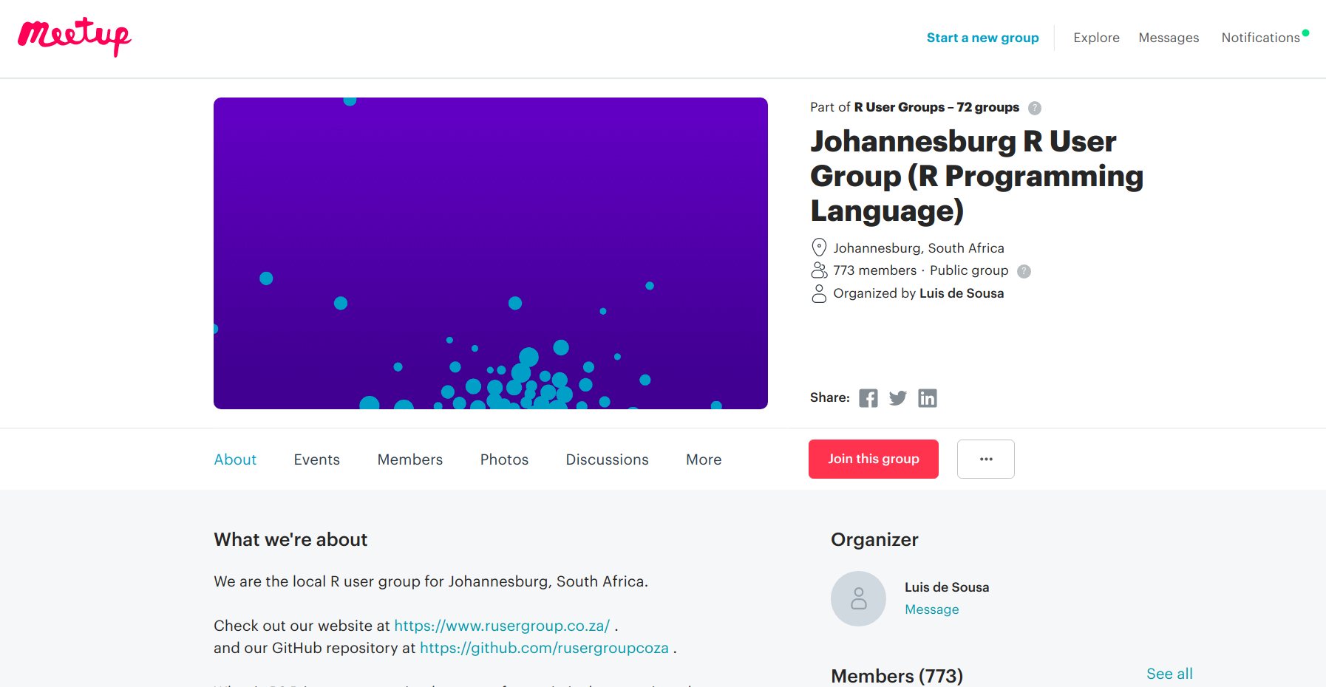


Slide 11
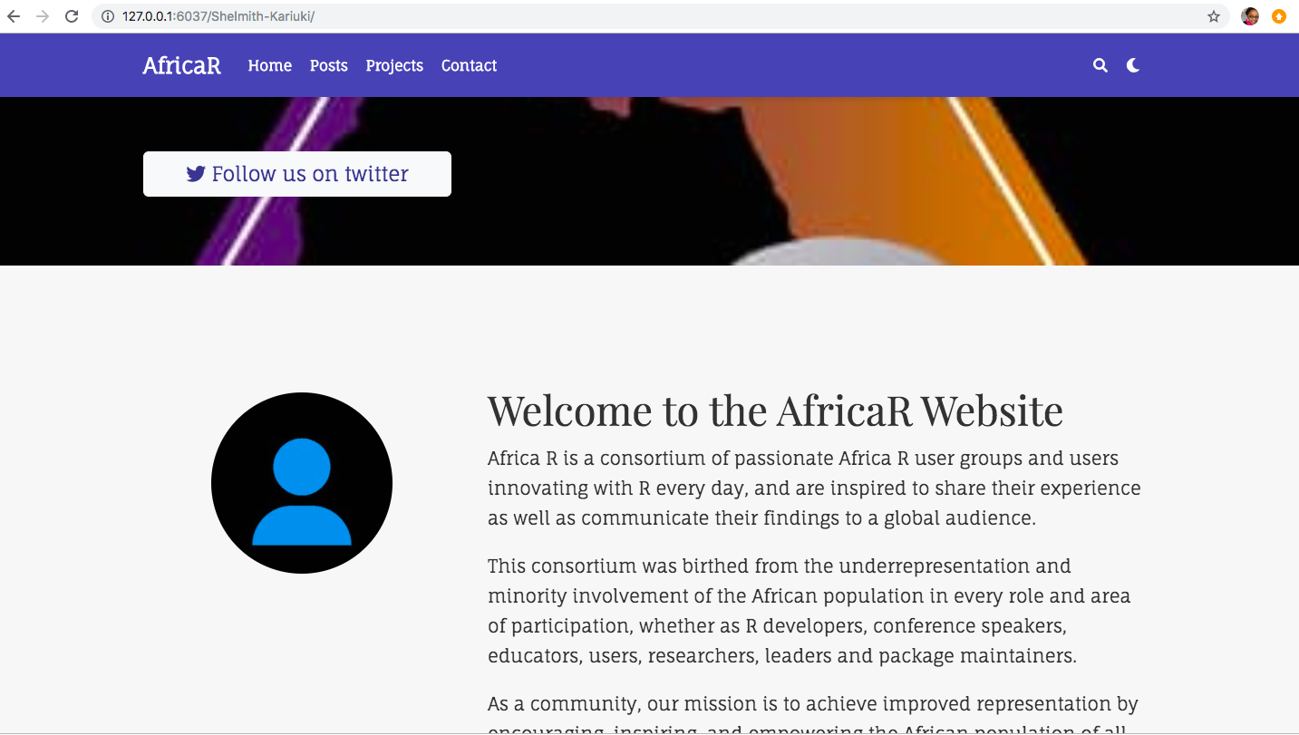
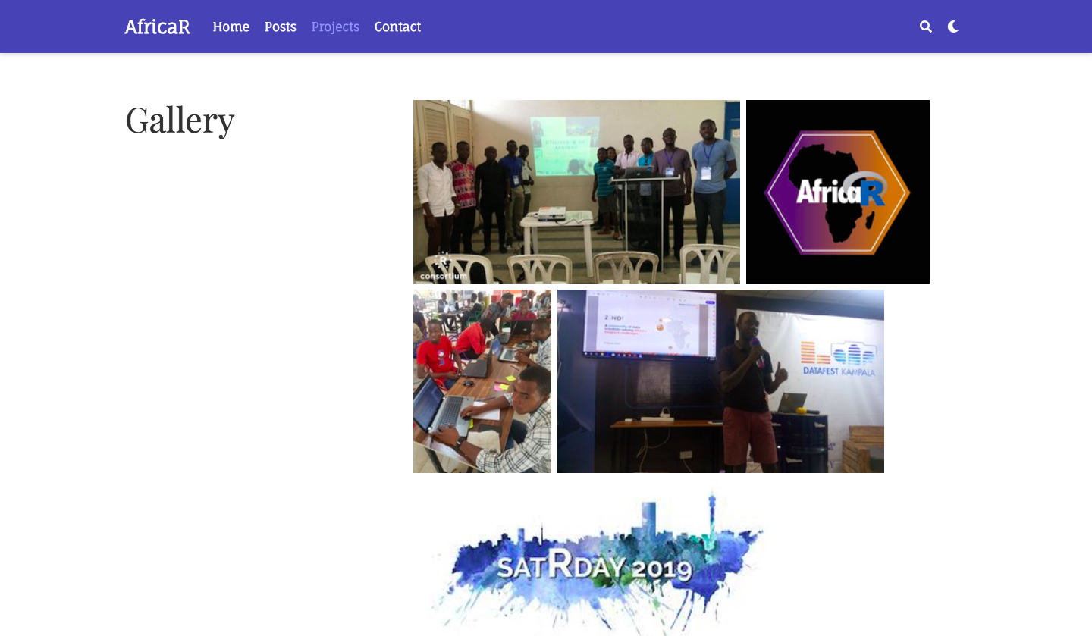
04: Develop a website https://africa-r.org/
Notes:
<number>

Slide 12

05: Set up R Clubs in Campuses

Slide 13

06: AfricaR Monetary Fund
Notes:
<number>

Slide 14

07: Have a grand AfricaR Conference
Notes:
African version of erum
3 days summer school, 2 days workshop
Venue should be a country with lenient travel rules (visas and passports)
<number>

Slide 15
What have we done so far?
Inception call with R Consortium
Gathered people who lead/planning to initiate ARUGs in their respective countries.
Inception call with the ARUGs leads team
Discussions about potential R Clubs in campuses
Discussions with different ARUG leads who needed support e.g Cairo, Lagos
SatRday Kampala
First remote internship opportunity
Discussions about 2020 AfricaR Conference
Jan
Feb
Mar
April
May
AfricaR Logo
Kikckstarting the website
Discussions with potential partners and sponsors
Twitter (@AfricaRUsers )

Slide 16
Quick Wins …

Slide 17
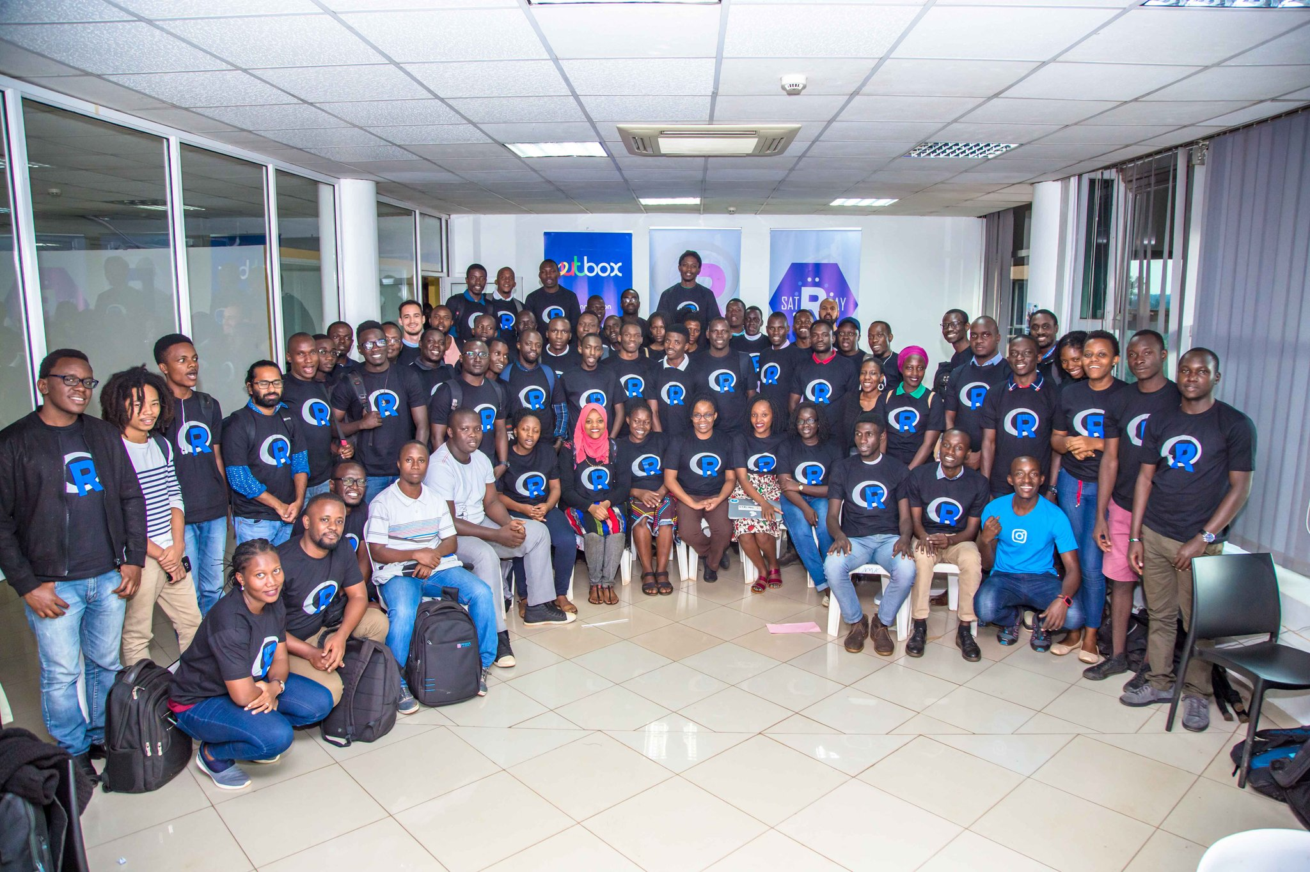

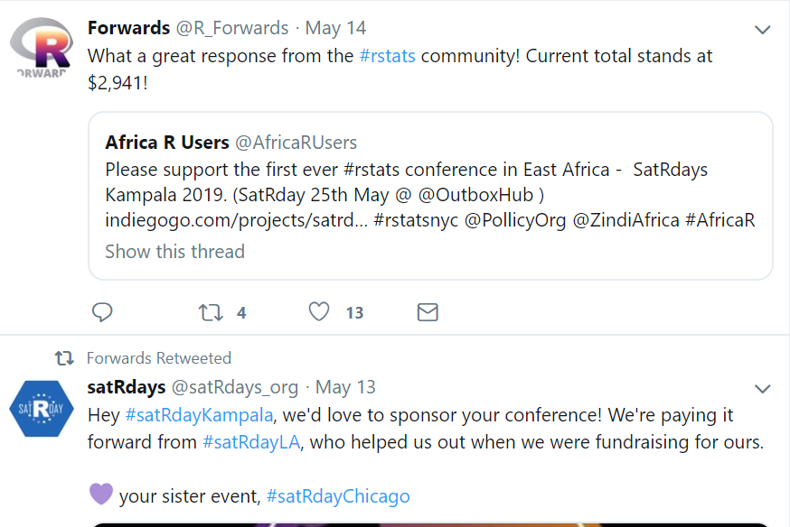


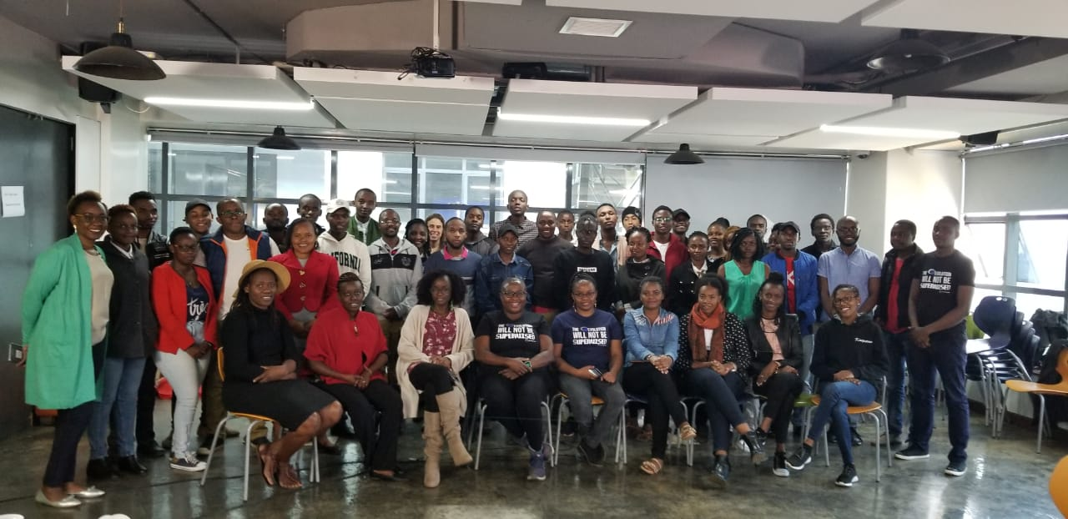
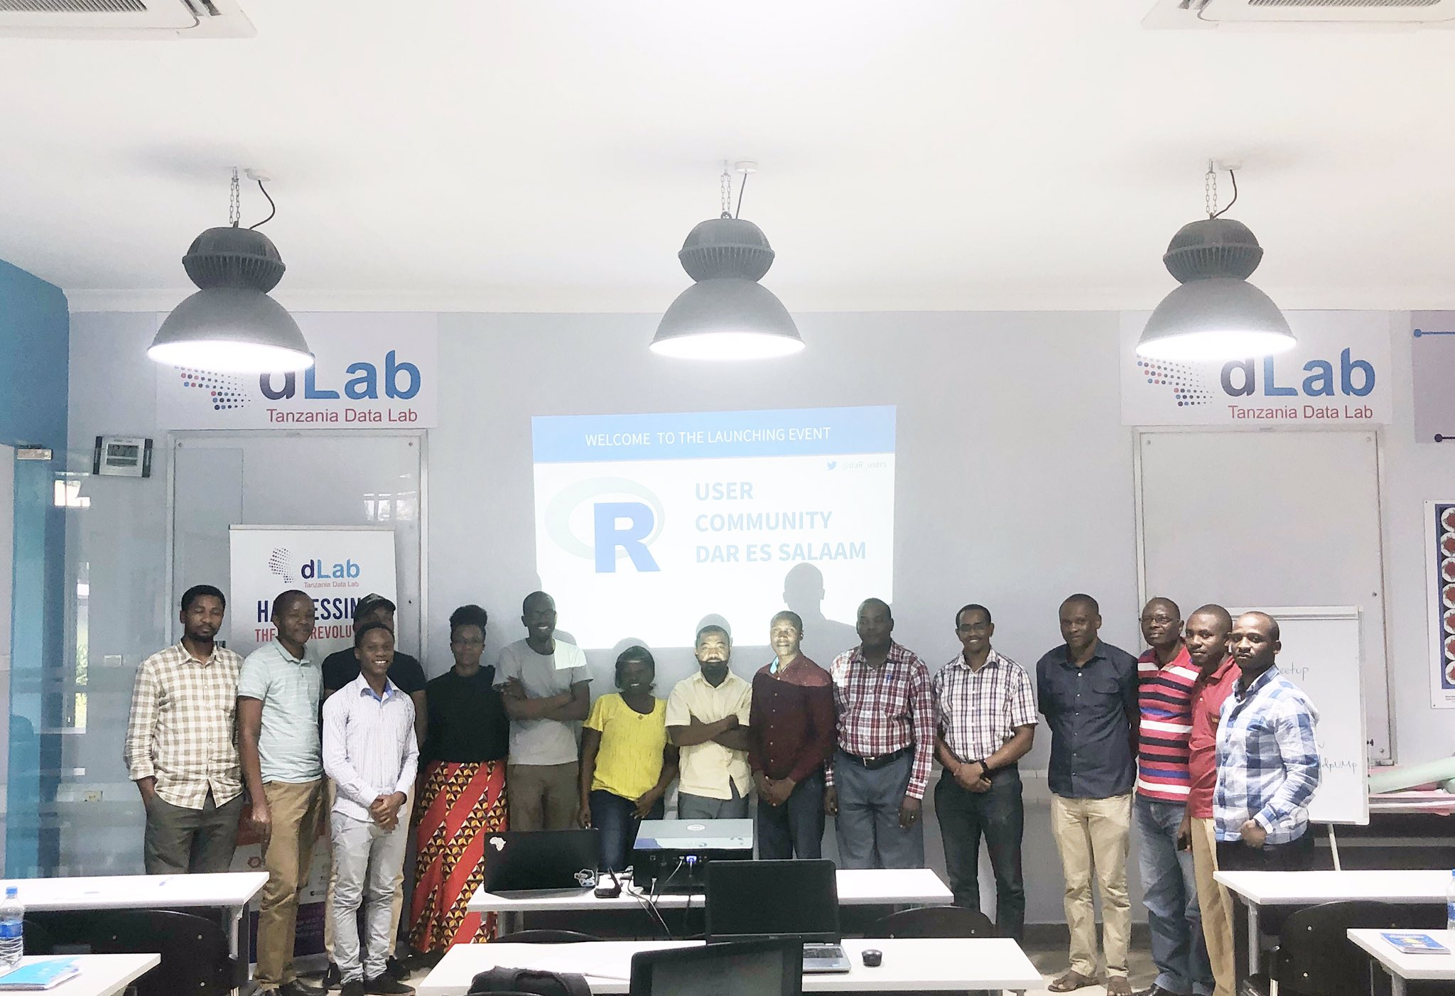
Notes:
Immense support from the #rstats community, for SatRday Kampala
Invitation to travel to France
<number>

Slide 18

La Fin .
Twitter: @AfricaRUsers
Gmail: africarusers@gmail.com
Website: https://africa-r.org/
Notes:
African version of erum
3 days summer school, 2 days workshop
Venue should be a country with lenient travel rules (visas and passports)
<number>

Slide 19


Des questions?
Notes:
African version of erum
3 days summer school, 2 days workshop
Venue should be a country with lenient travel rules (visas and passports)
<number>

